Slide 1

SignConnect: Sign Language Web Conferencing Tool
Dzeke Etornyo Kwame
3030220
Danso Isaac
3029420

Slide 2

Outline
Background
Methodology
1
6
Problem Statement
Tools & Stacks
2
7
Objectives
Design
3
8
Significance
Timeline
4
9
Literature Review
Conclusion
5
10

Slide 3
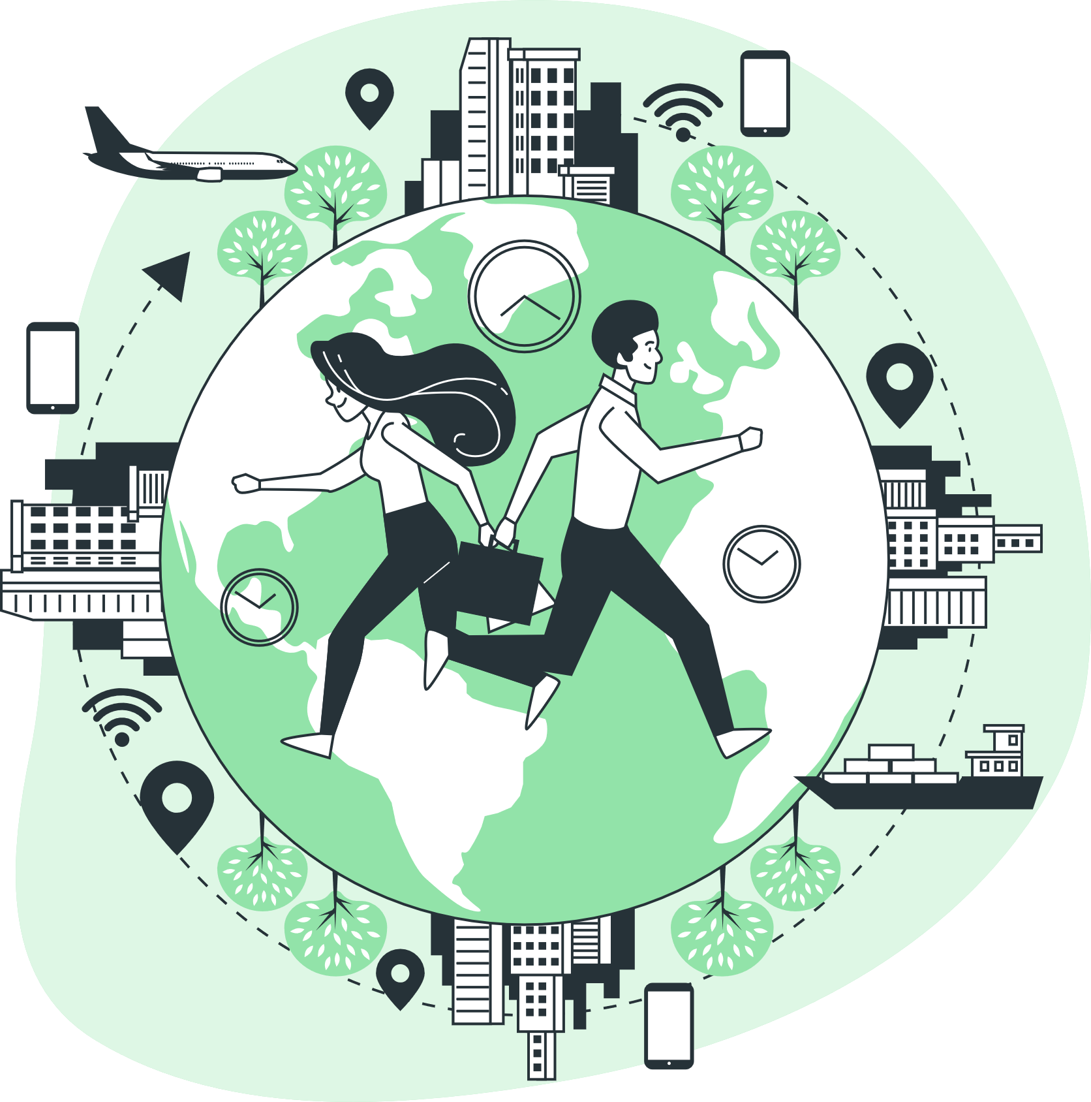
Background
Global Community

Slide 4


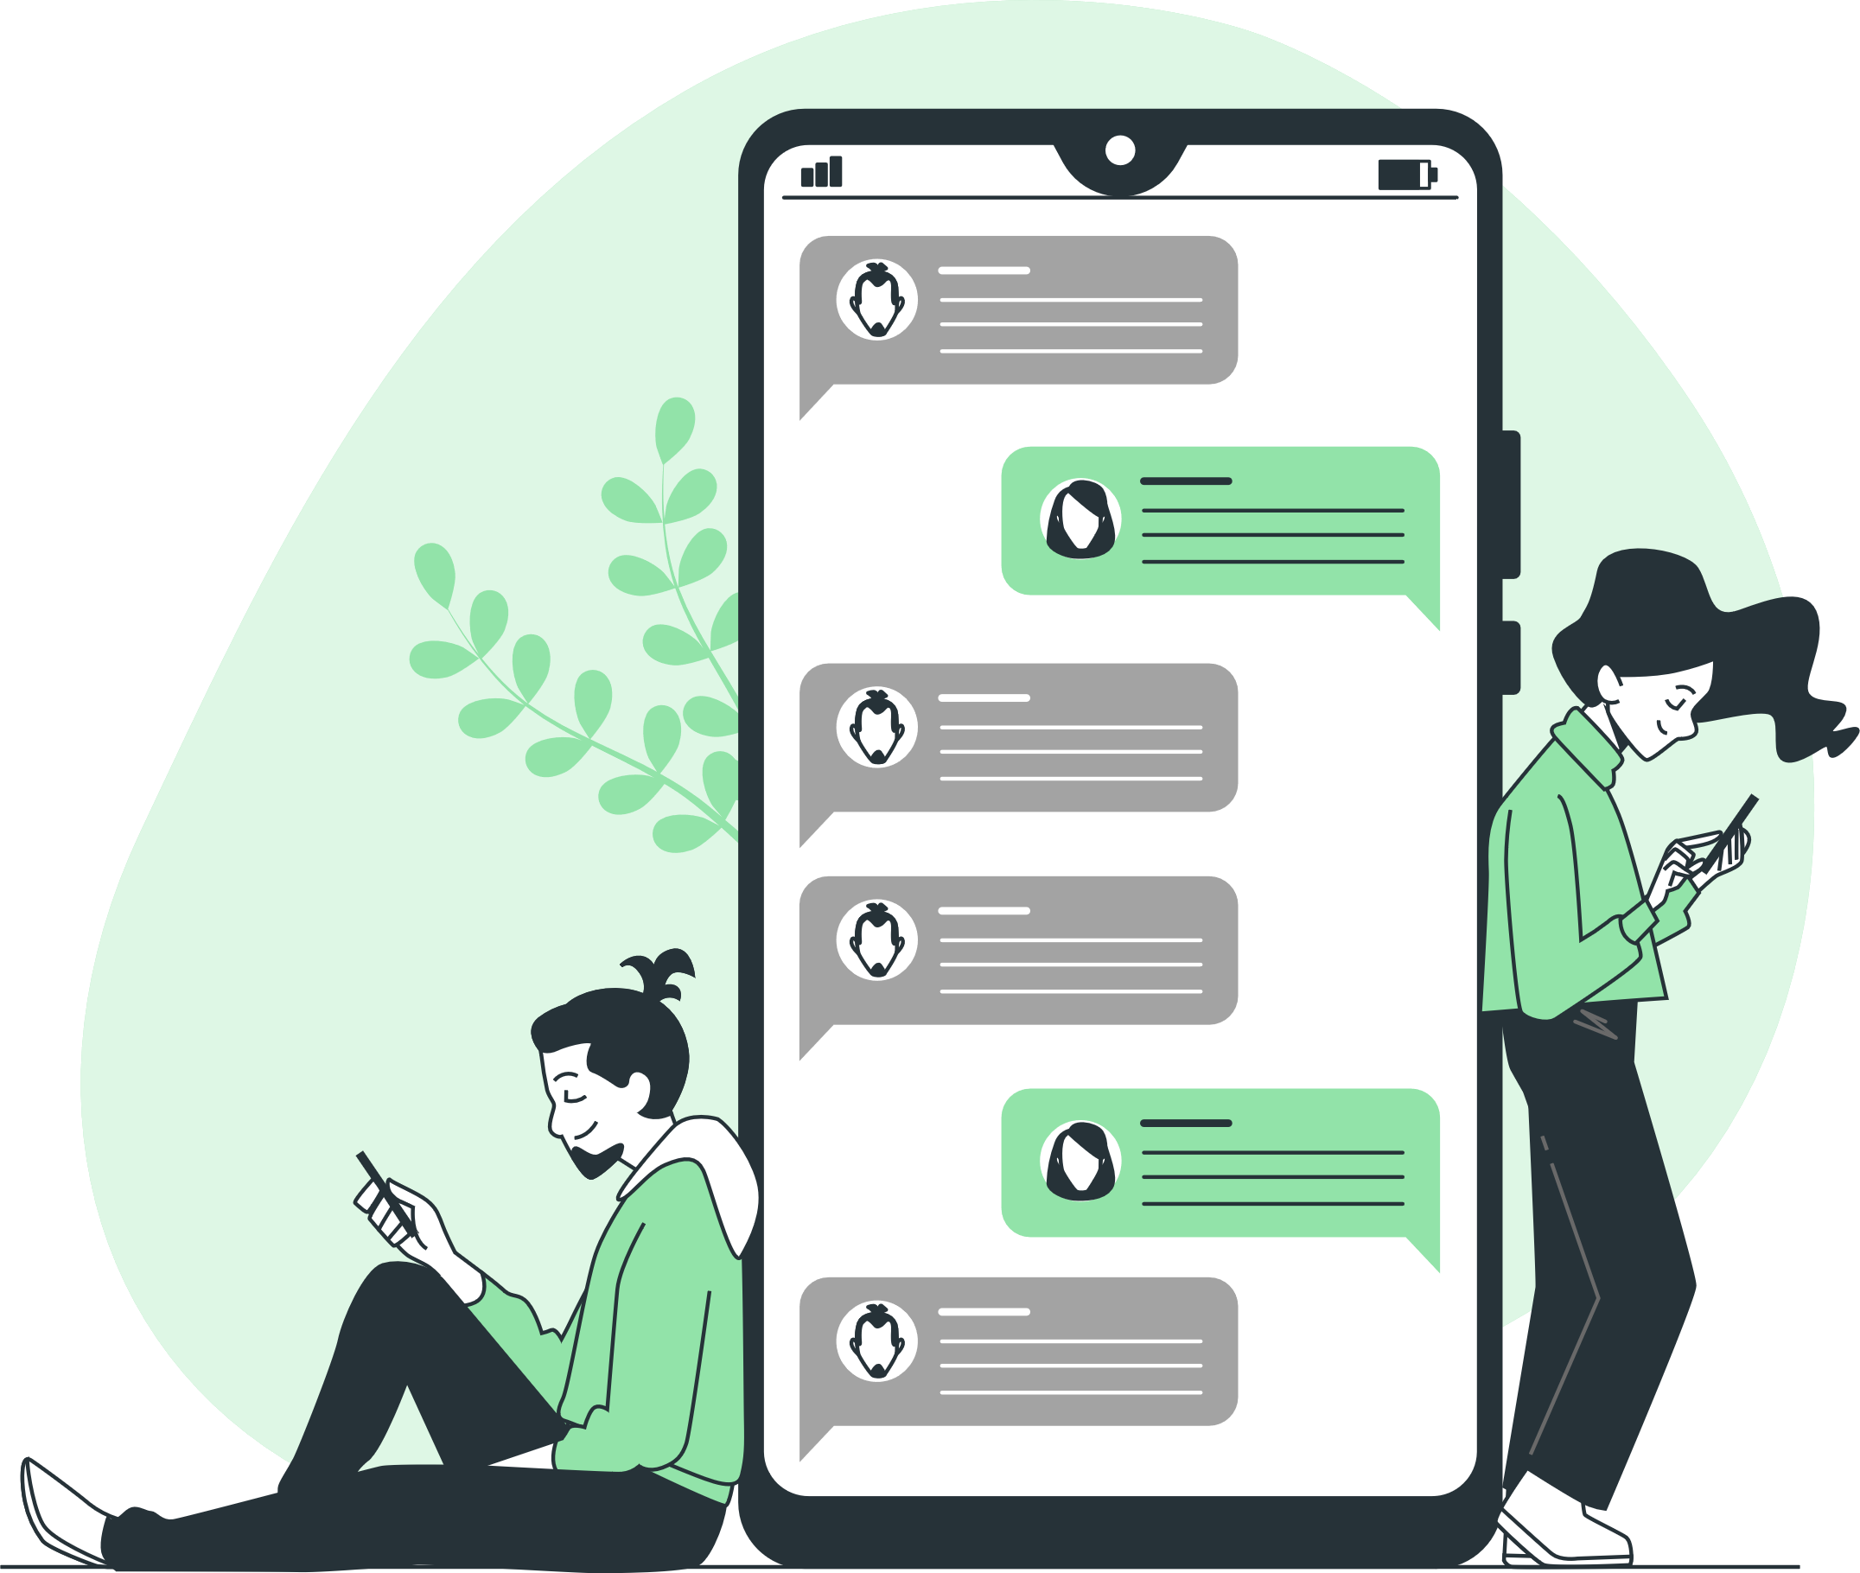

Calls
Text
Digital communication
Email

Slide 5
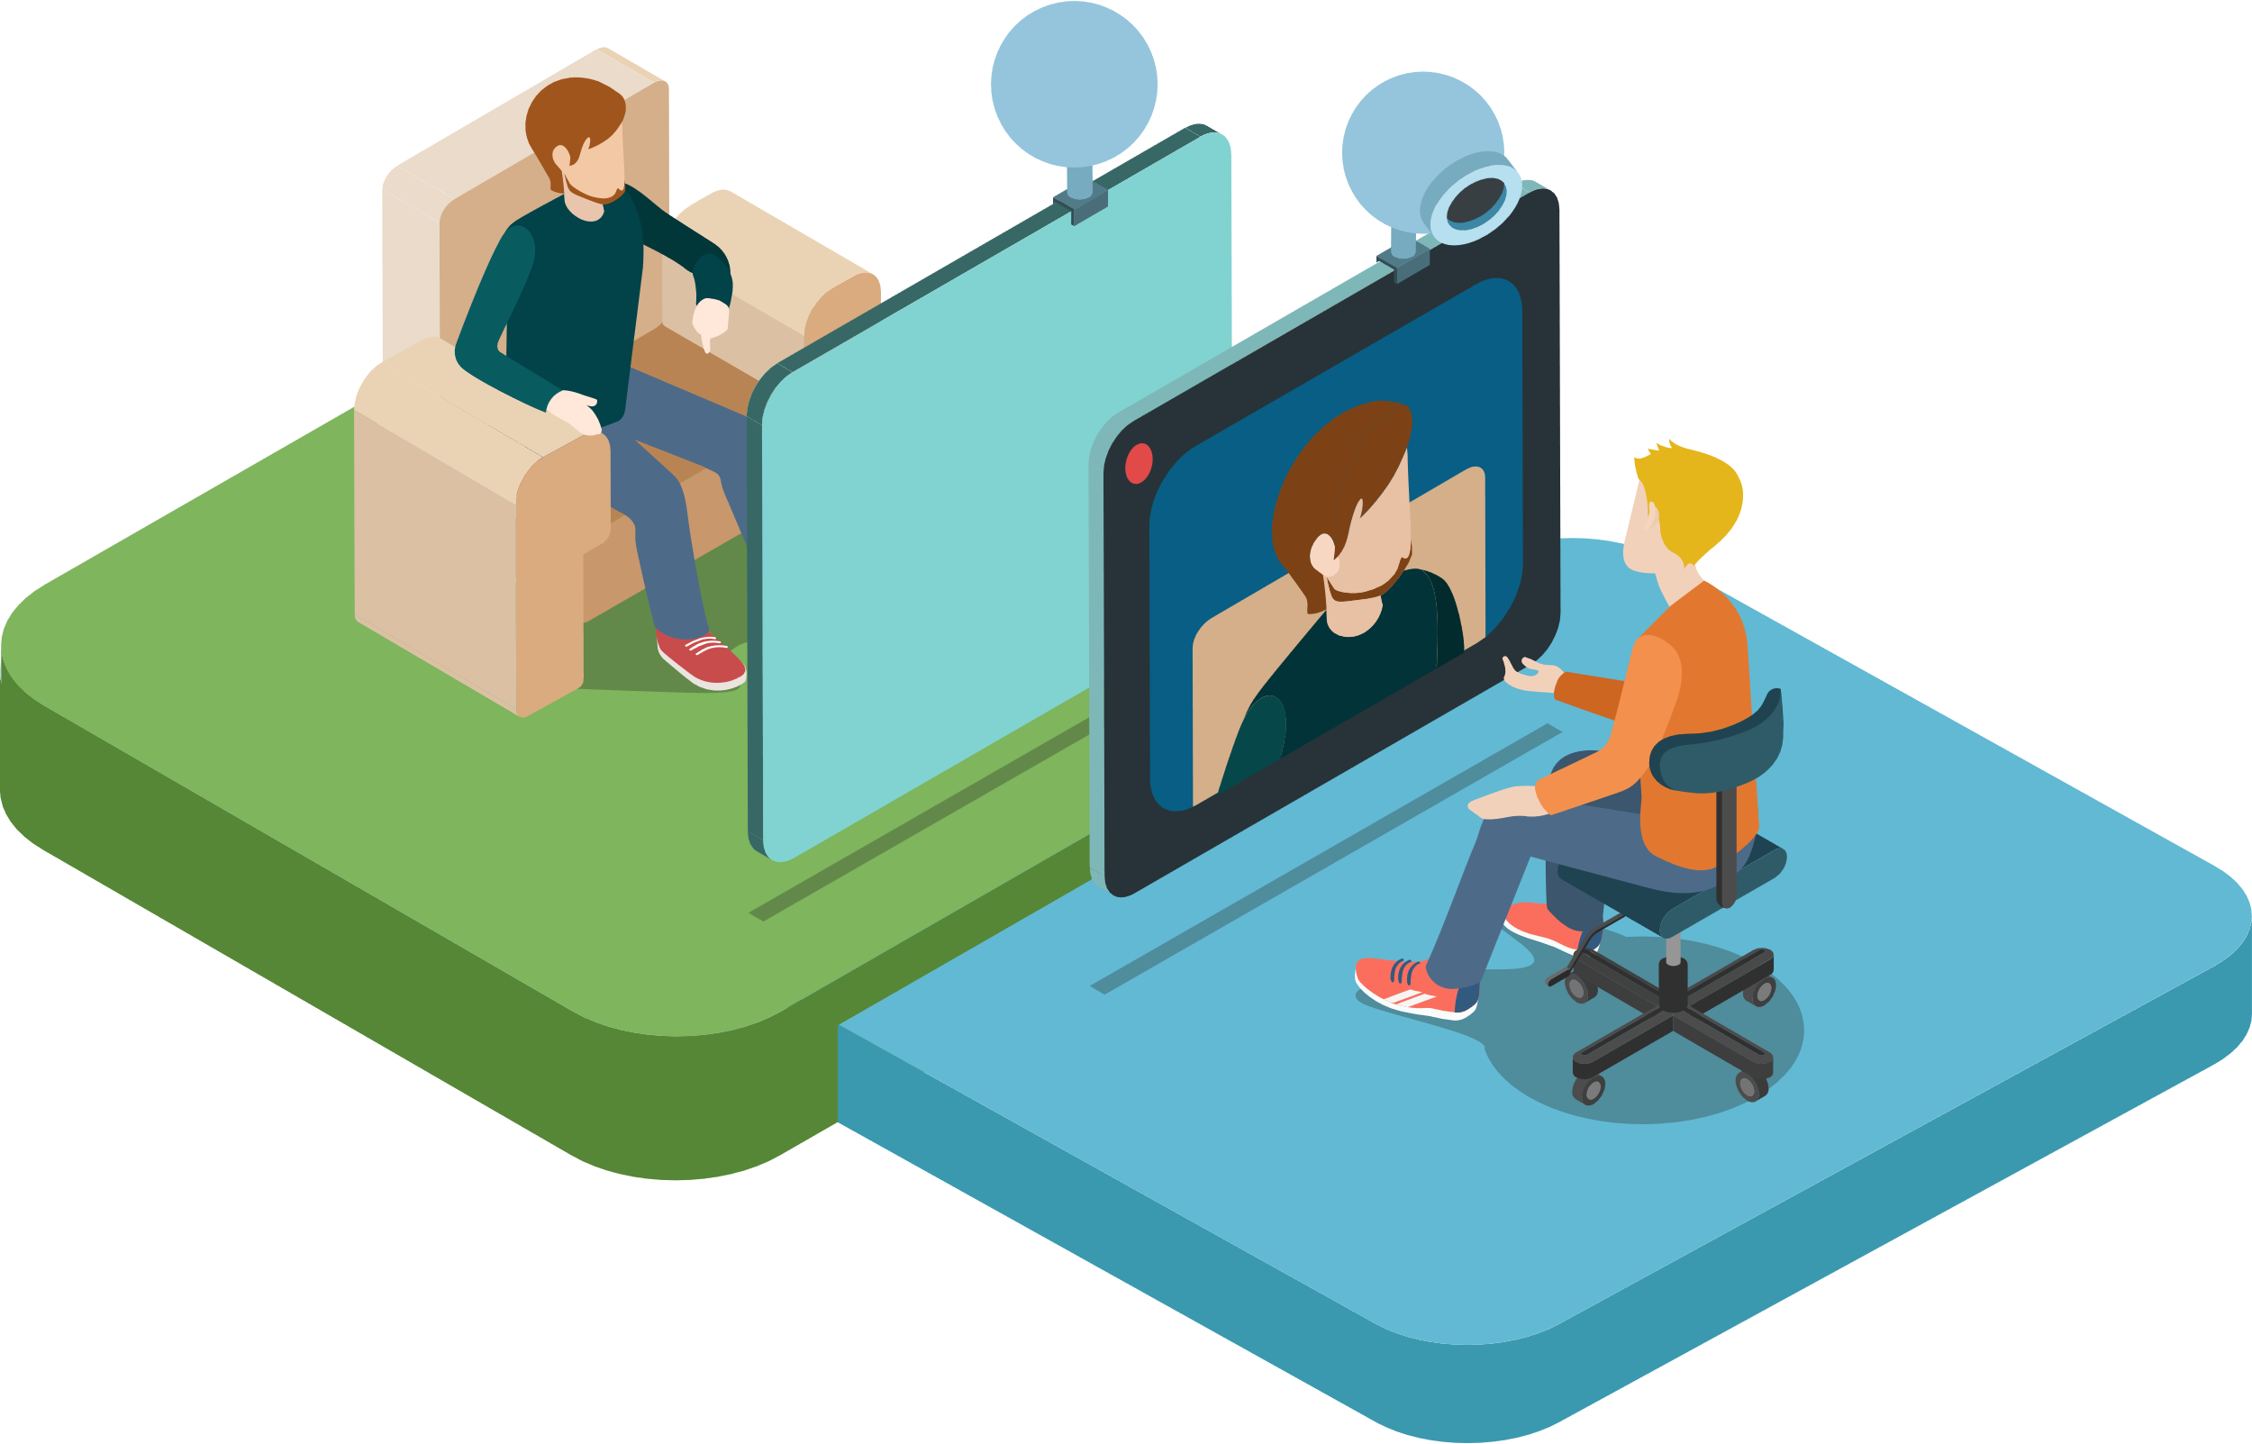
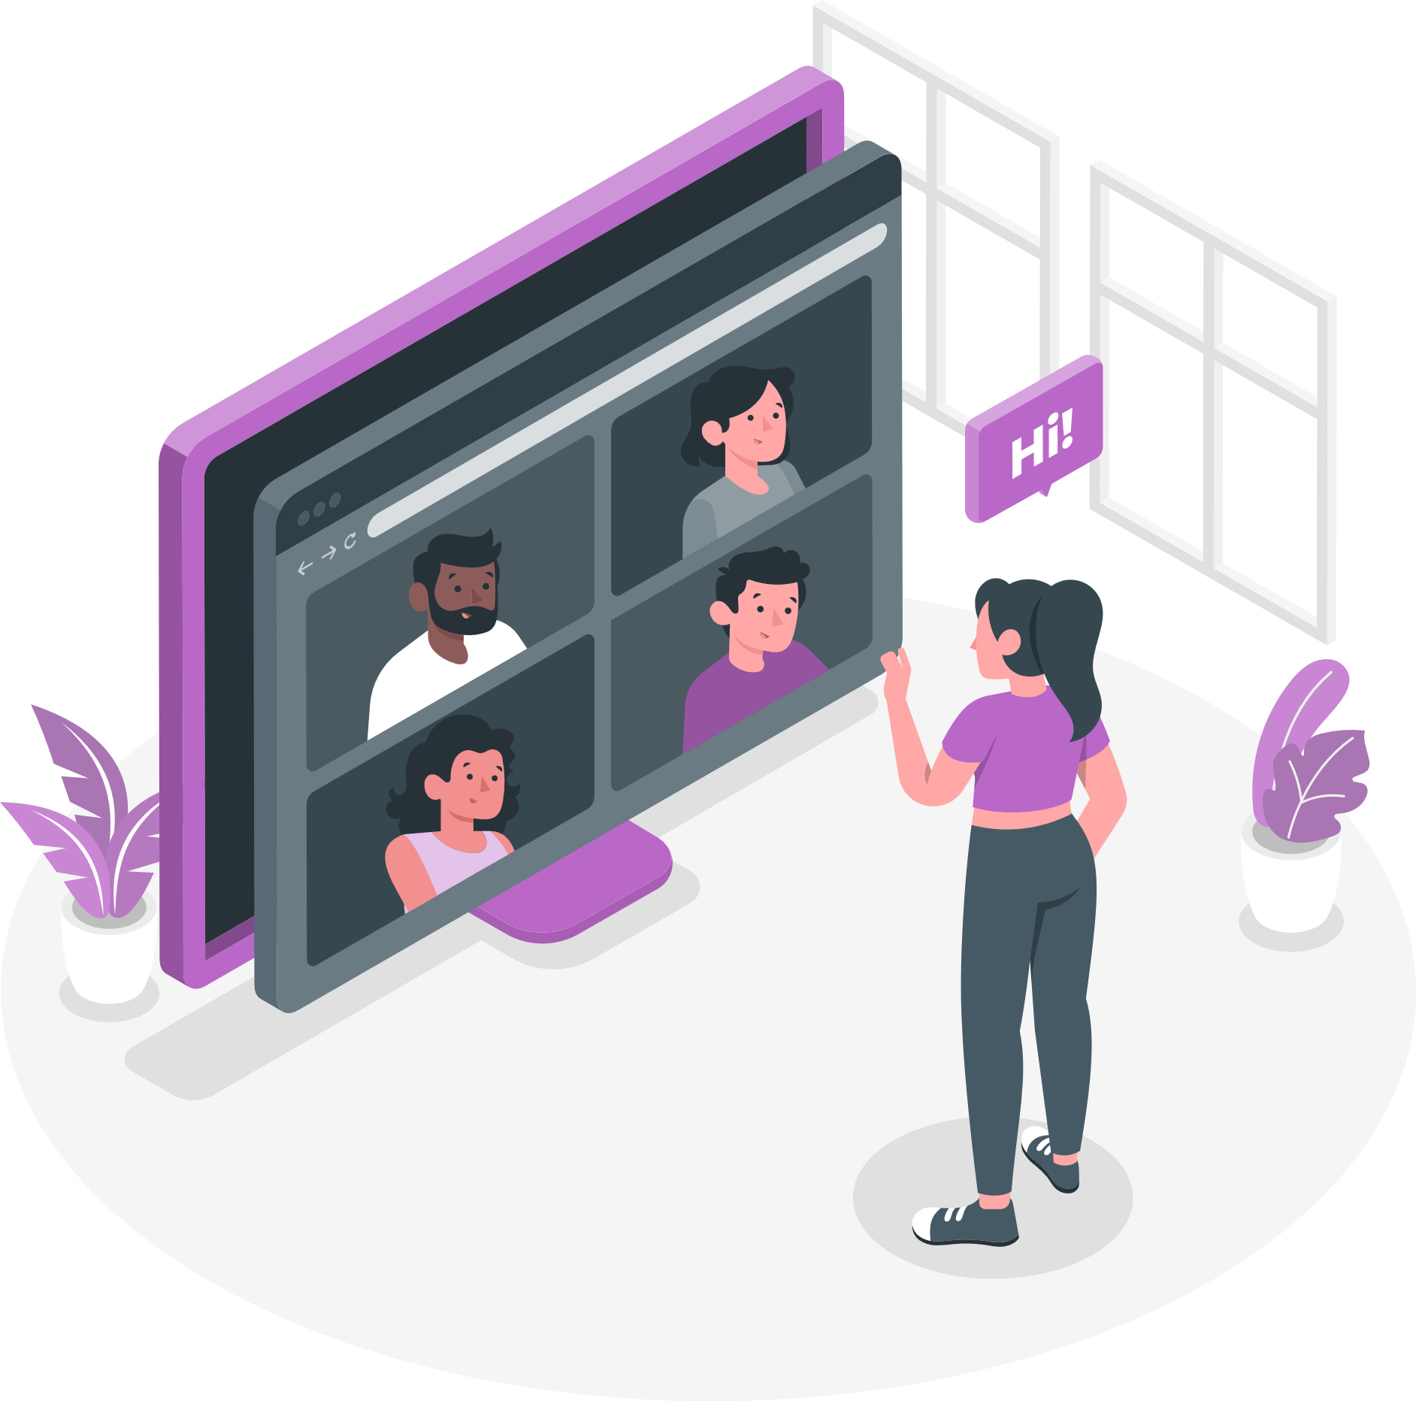
Video Conferences

Slide 6

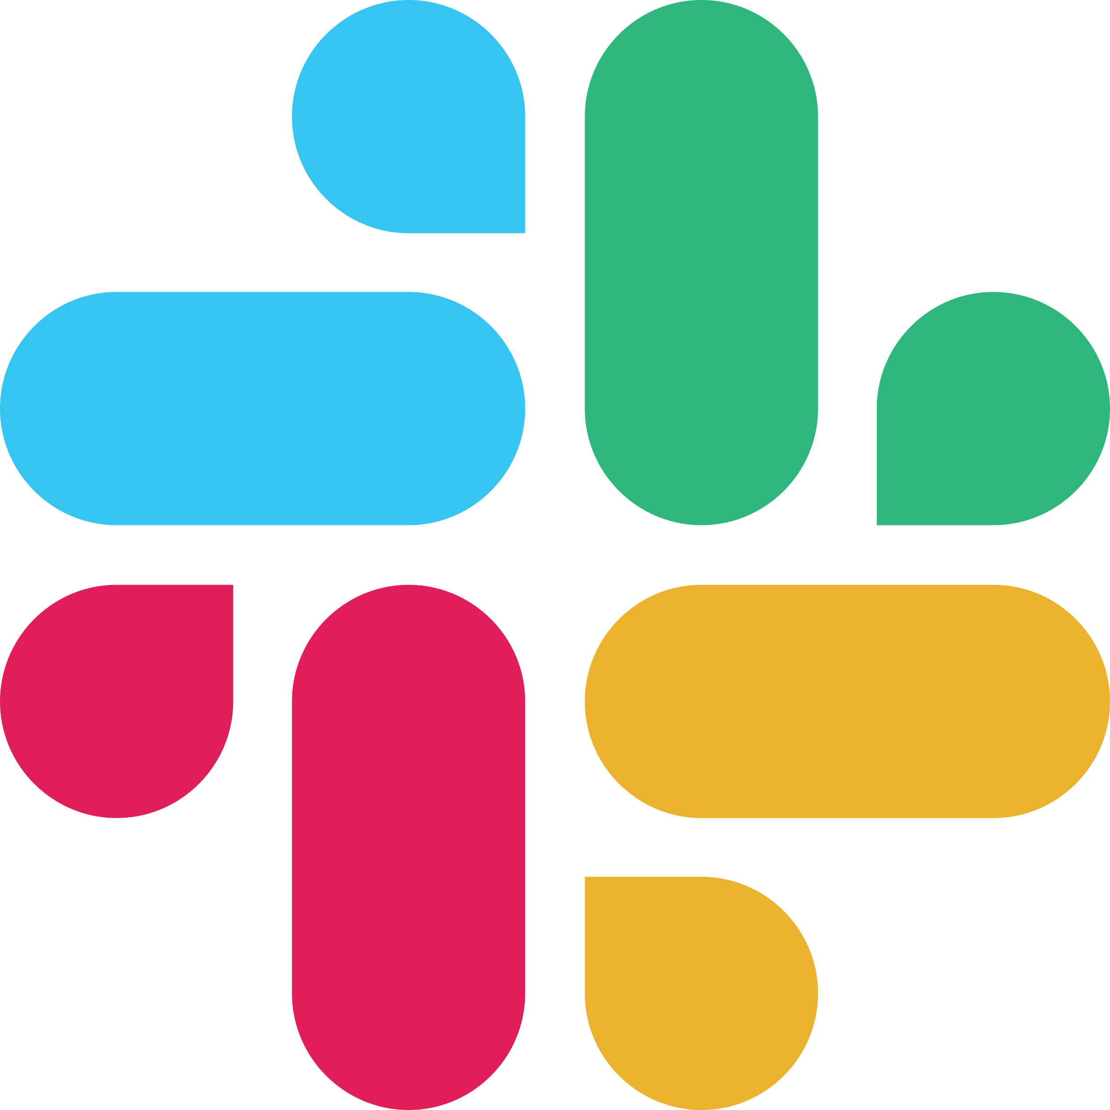




Slide 7
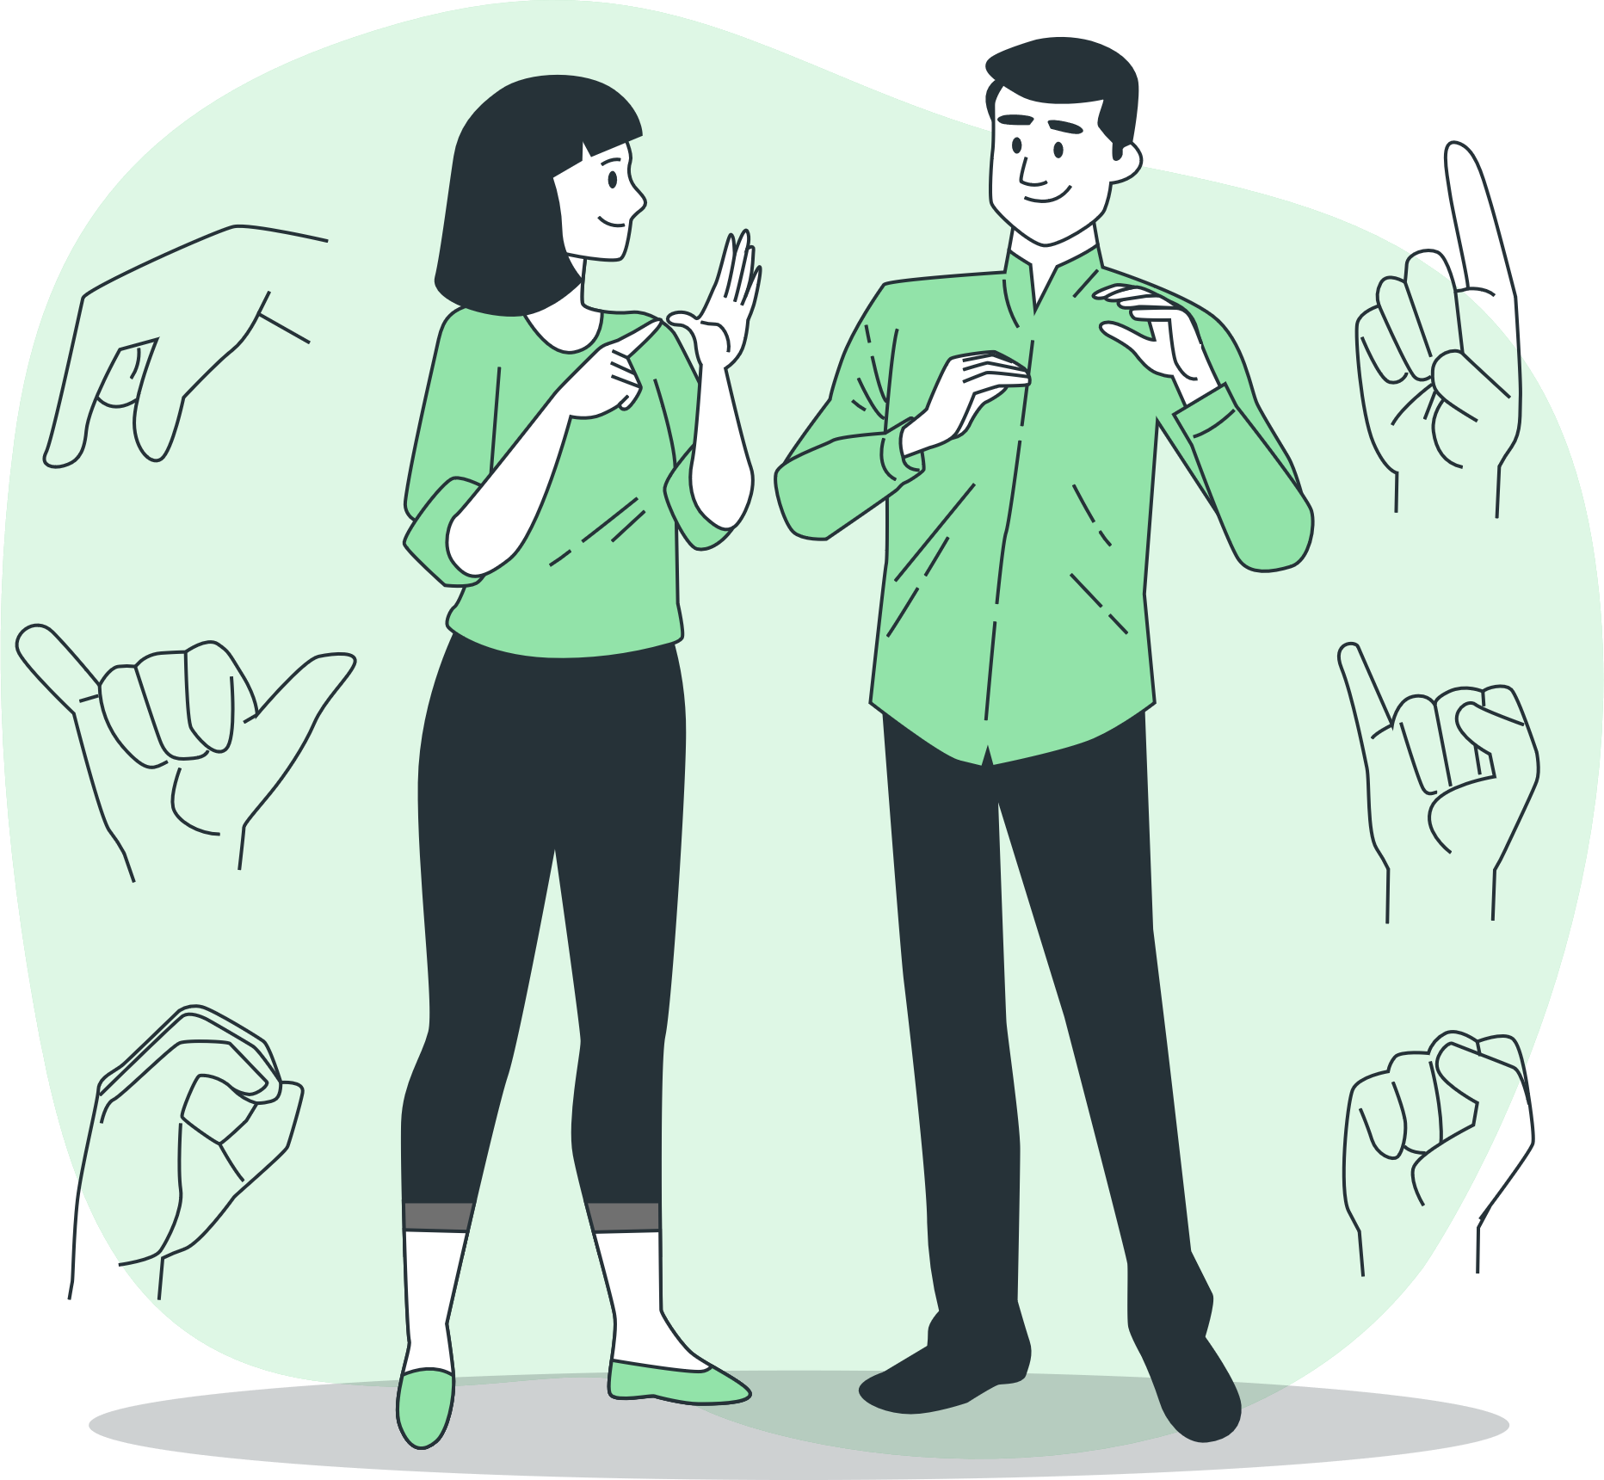
Deaf and Hard-of-Hearing
(DHH) Community

Slide 8

Problem Statement
There are no known video conferencing applications which are friendly to the DHH Community

Slide 9
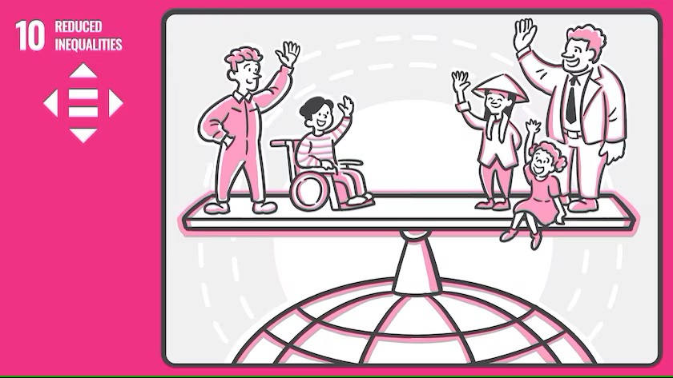
Inspiration

Slide 10
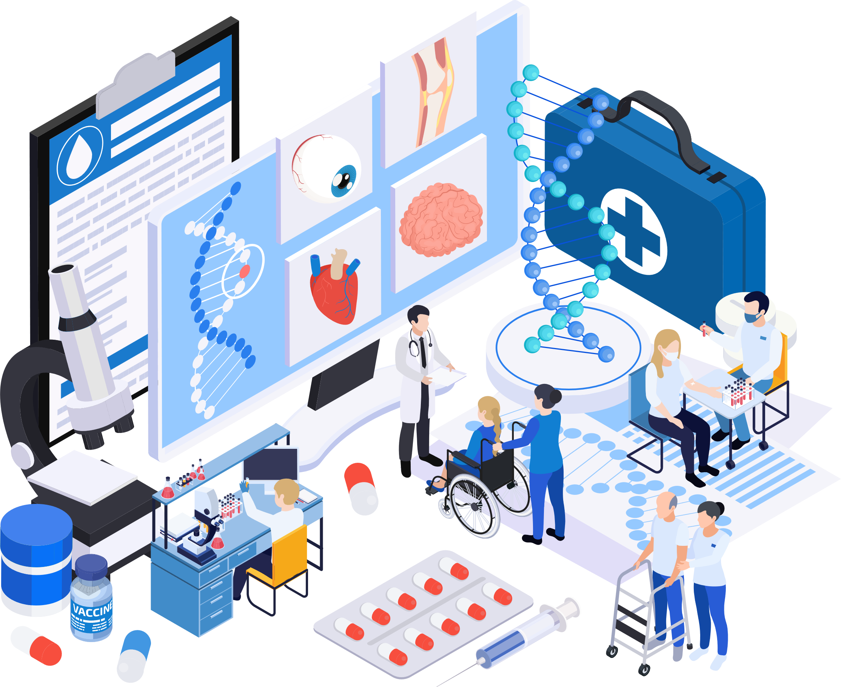
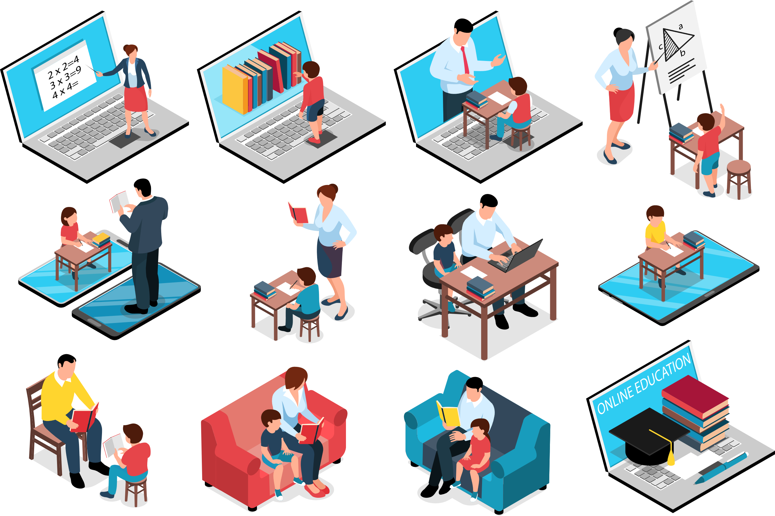
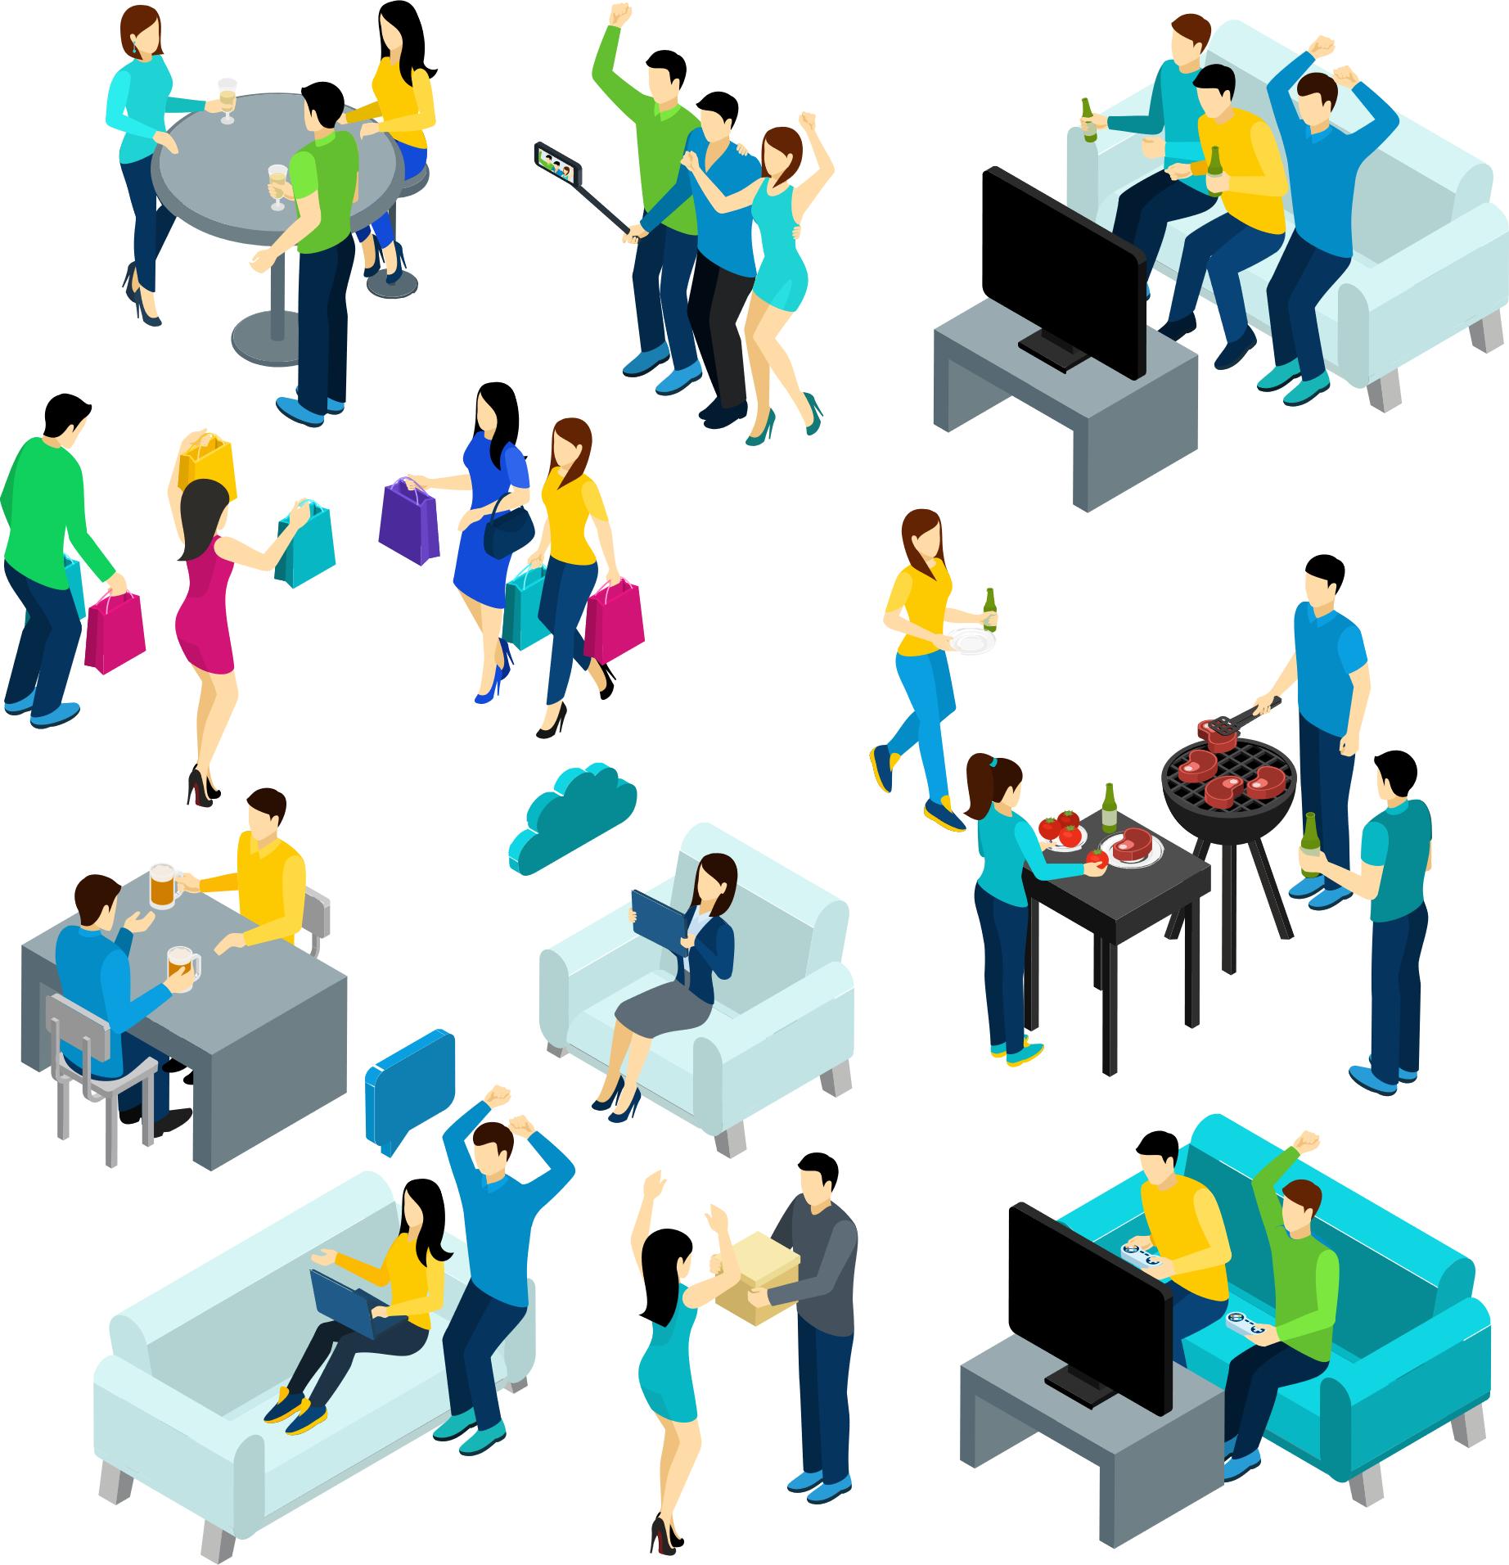
Health
Education
Social Interaction

Slide 11
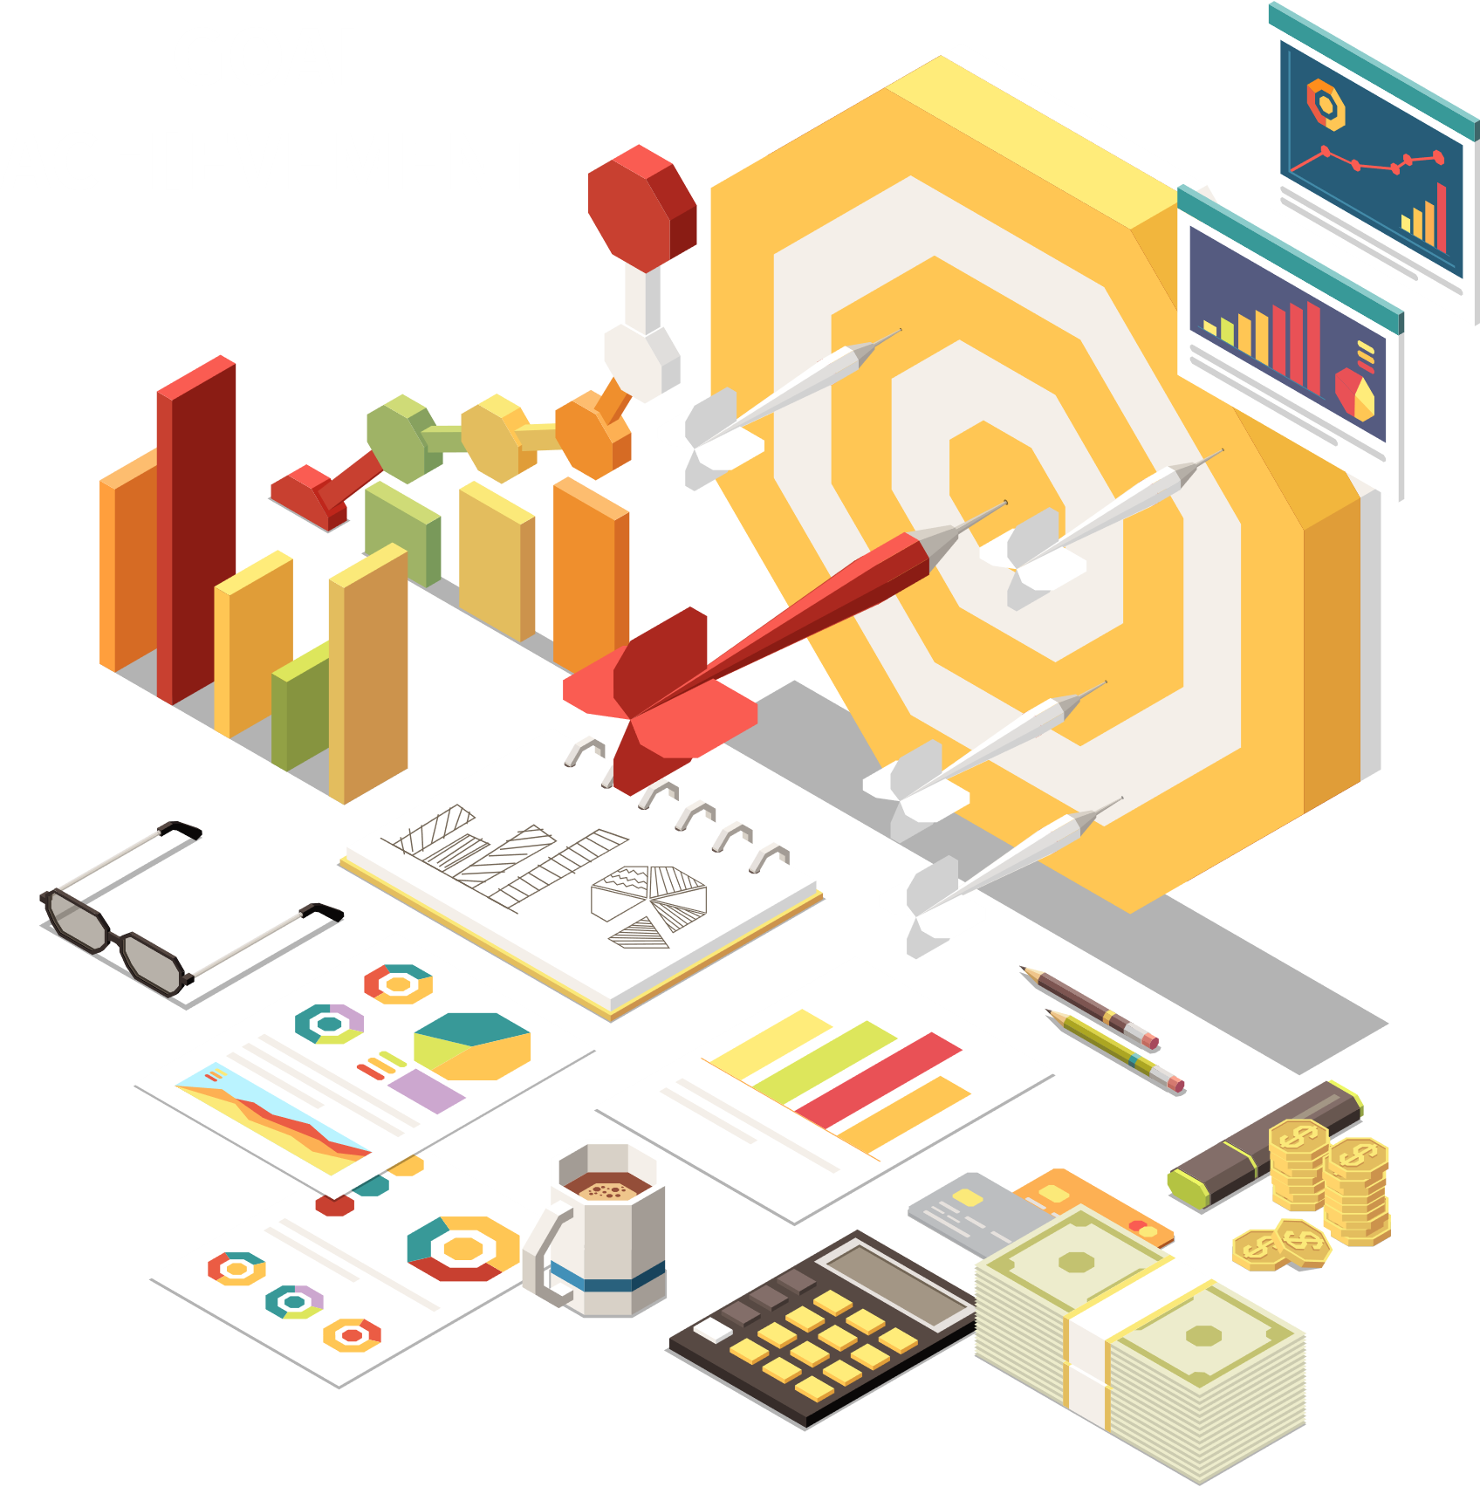
Objectives

Slide 12
Objectives
General
Specific
Build a user friendly web conferencing application capable of Sign Language translation
Landmark Detection
Posture Detection
Gesture Detection
Customizable Avatar Options
Support for Multiple Languages and Sign Languages

Slide 13
Significance
To revolutionize communication for deaf individuals with others, making it easier and more effective.
To enable deaf individuals to participate more fully in various aspects of life, such as education, employment, and social interactions.

Slide 14
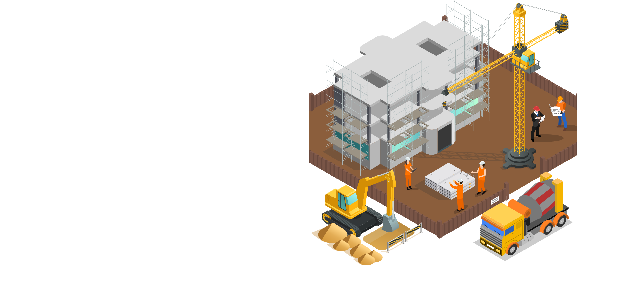
Related Works Overview

Slide 15
Metrics/Projects | American Sign Language Recognition Using Deep Learning and Computer Vision. | Indian Sign Language Gesture Recognition Using Image Processing and Deep Learning. | Deep Learning-Based Approach for Sign Language Gesture Recognition with Efficient Hand Gesture Representation | Bengali Sign Language detection
Models | Convolutional Neural Networks (CNN) with the Inception Recurrent Neural Network (RNN) model known as Long Short-Term Memory (LSTM) | multi-layered CNN architecture for static gestures and LSTMs with convolutional kernels for dynamic gestures. | Histogram of Oriented Gradients (HOG) and Convolutional Neural Networks (CNN). | K-Nearest Neighbour Haar-like feature based classifier
Accuracy(%) | 99 | 99.08 - Indian Sign Language 97.71 - American Sign Language - | 94.3 | 98.17
Limitations | Limited to ASL | Limited to Indian Sign Language | Worked on static sign language (Pictures) | Recognized only vowels and consonance

Slide 16

Methodology

Slide 17
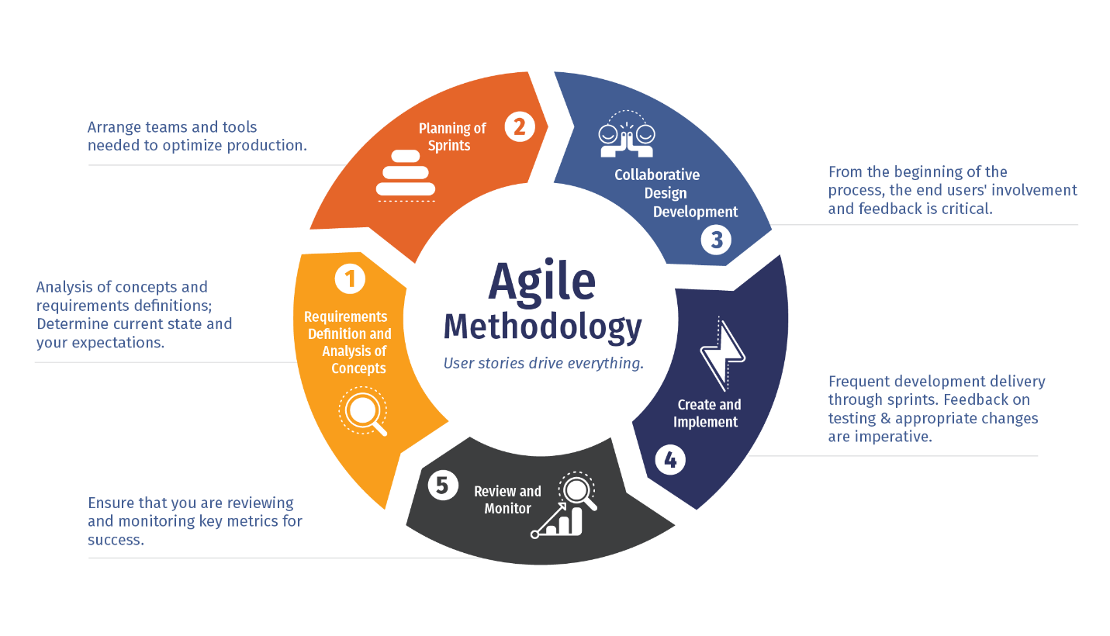

Slide 18
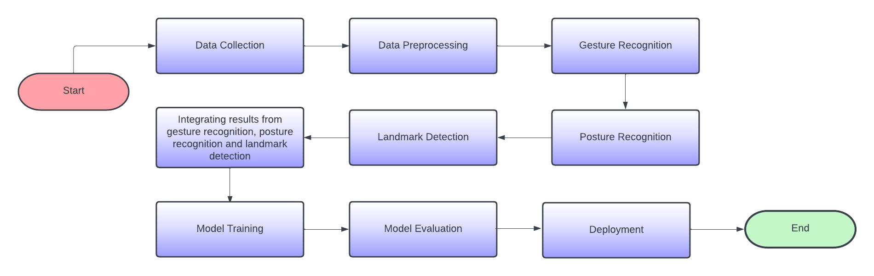
CNN
Block Diagram

Slide 19
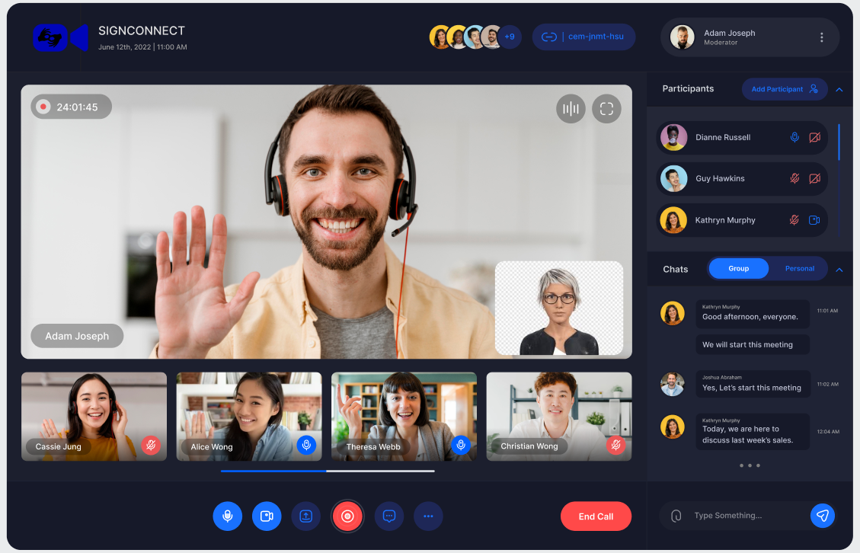
UI/UX

Slide 20

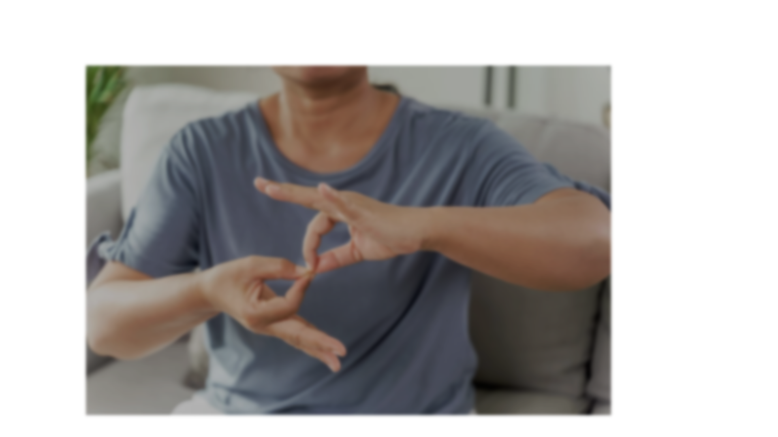




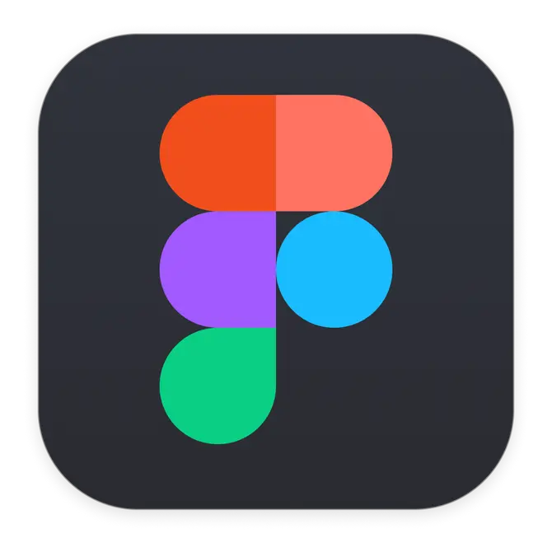

Python
React
MongoDB
Figma
GitHub

Slide 21
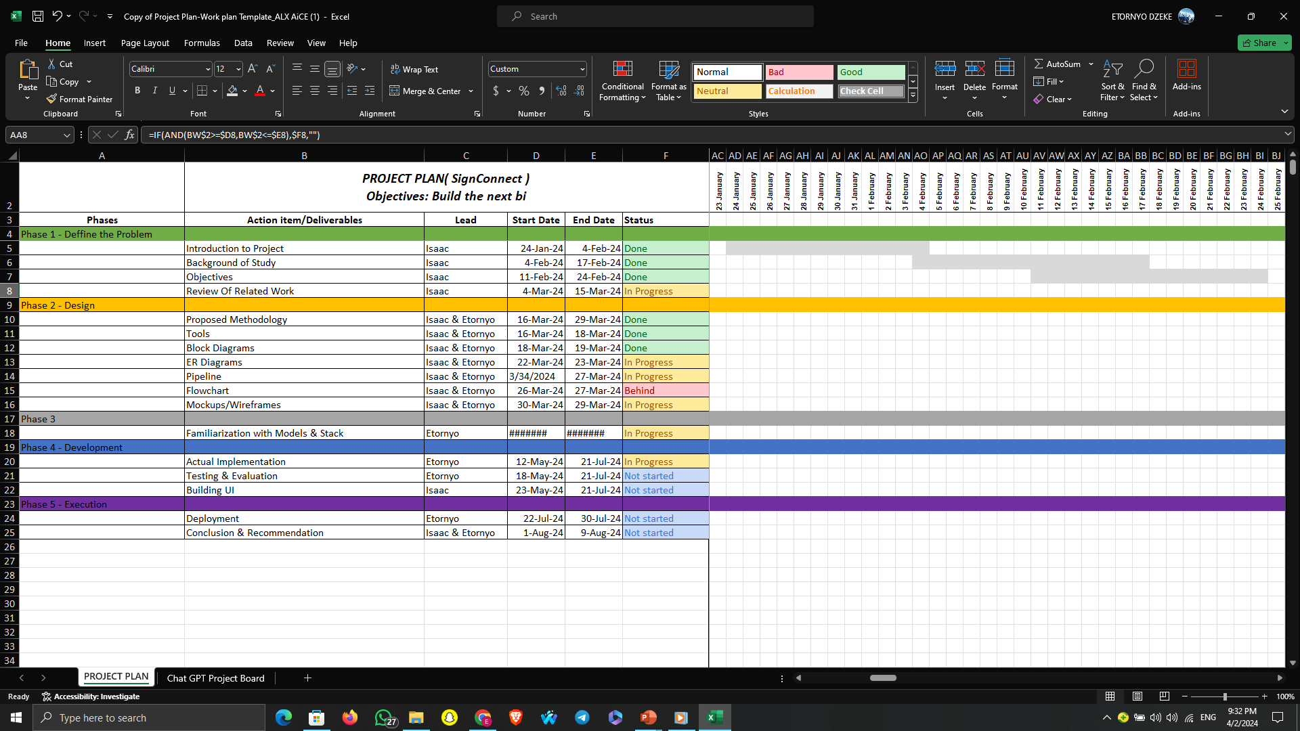

Slide 22
Conclusion

